Slide 1

Academic Darwinism:
Social Network Dynamics in Students
Final Project – Social Media Analytics
Arham Anwar | 261137773
Arnav Gupta | 260658711
Ethan Pirso | 260863065
Jatin Suri | 261152263
Hongyi Zhan | 261159589

Slide 2
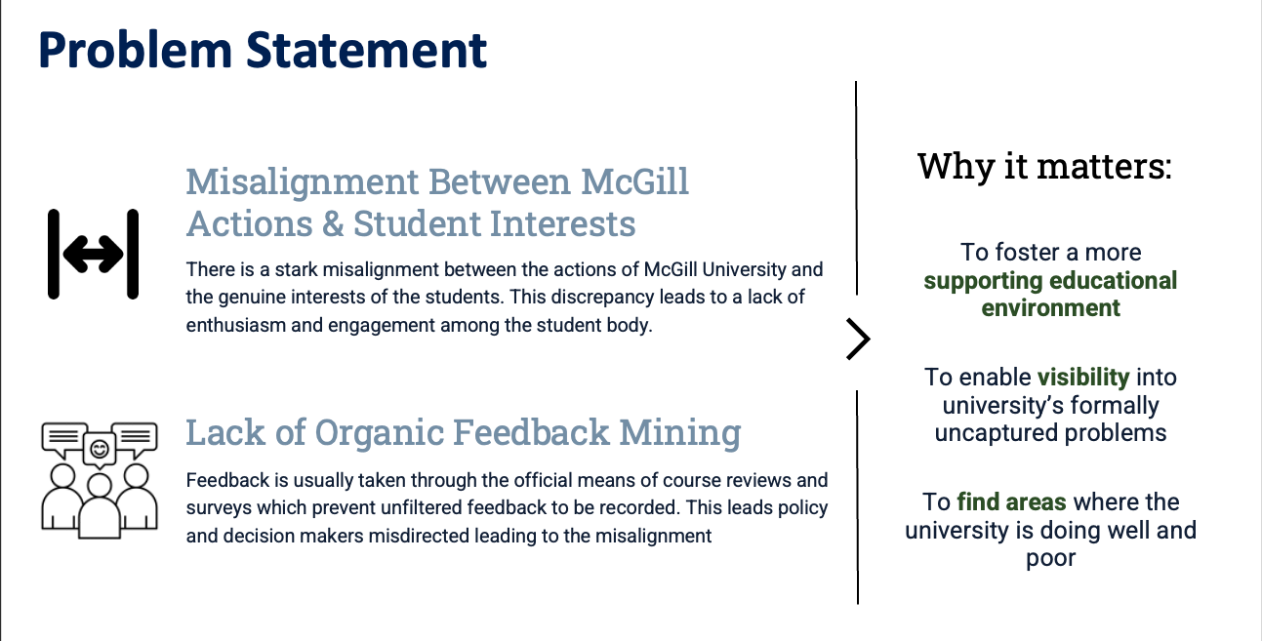
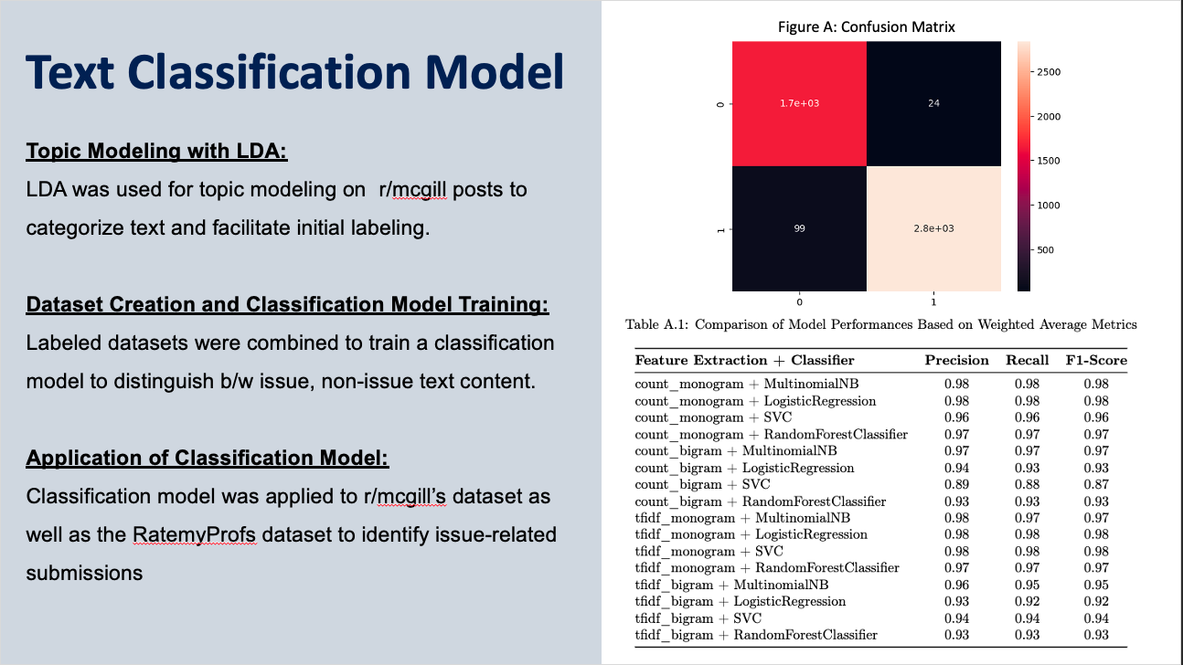
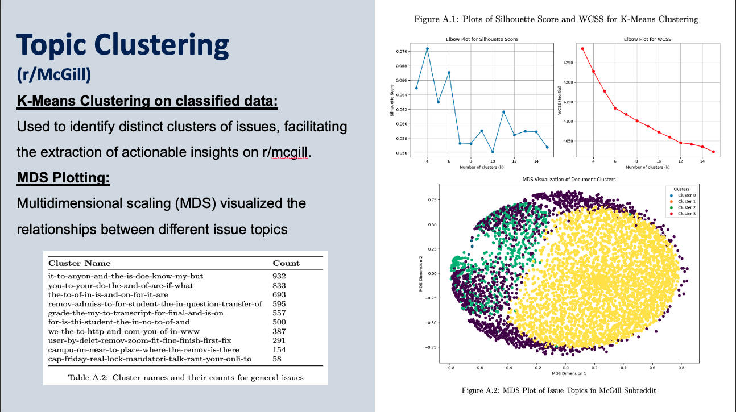
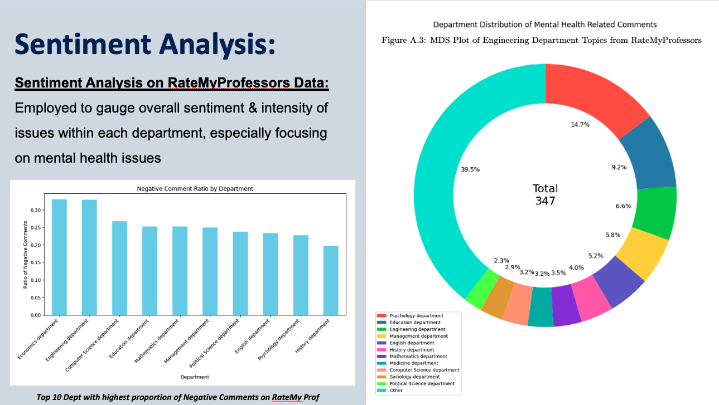
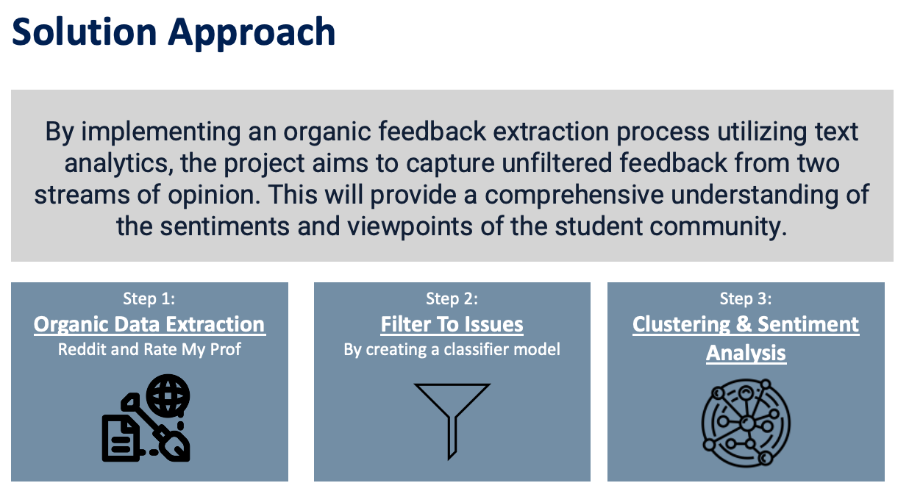
Organic Feedback Mining
what McGill Students say behind the filter
INSY-669-076
Recap:
From our previous project in Text Analytics, we have observed that unmoderated online platforms like Reddit are able to provide a more candid view of student experiences and we were able to identify core issues.

Slide 3

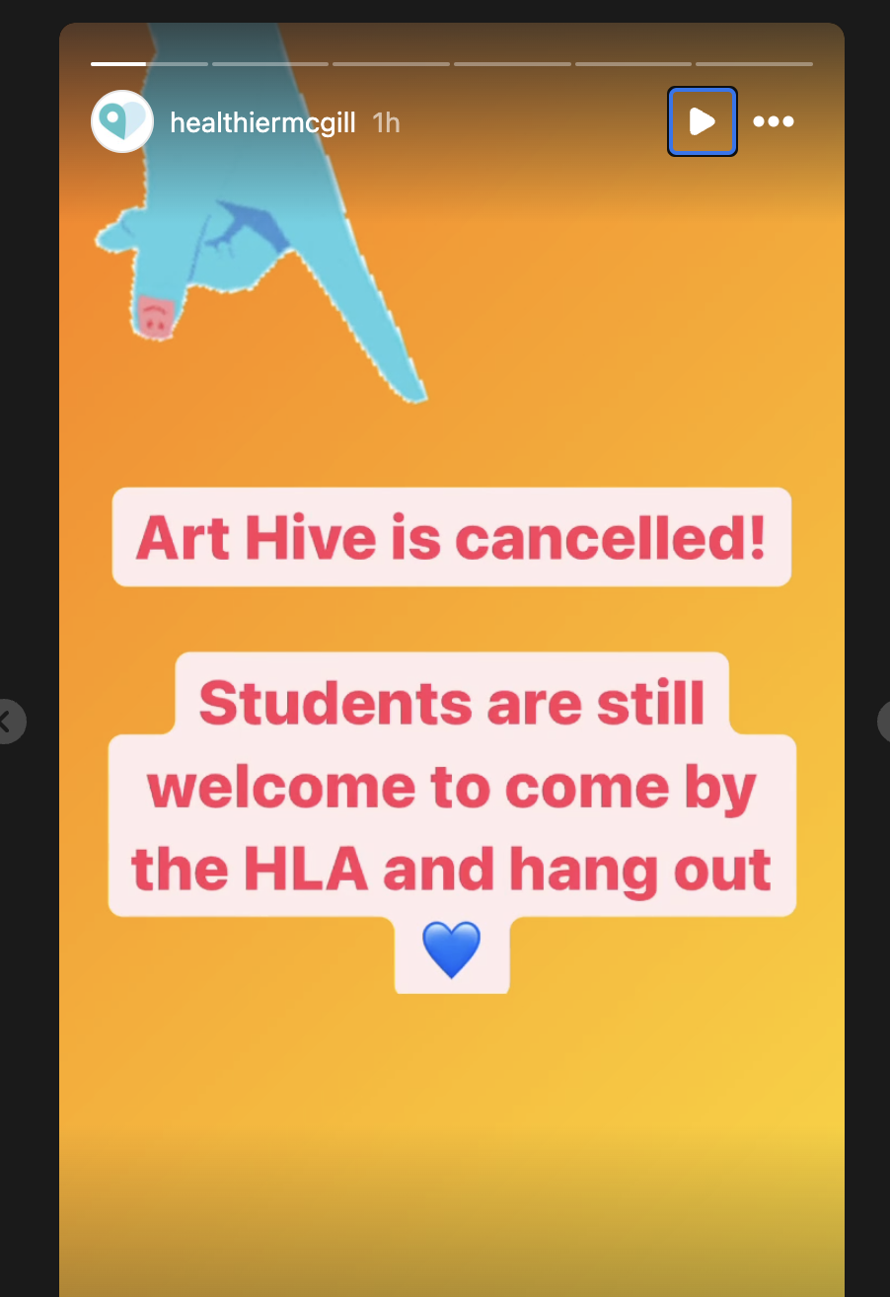
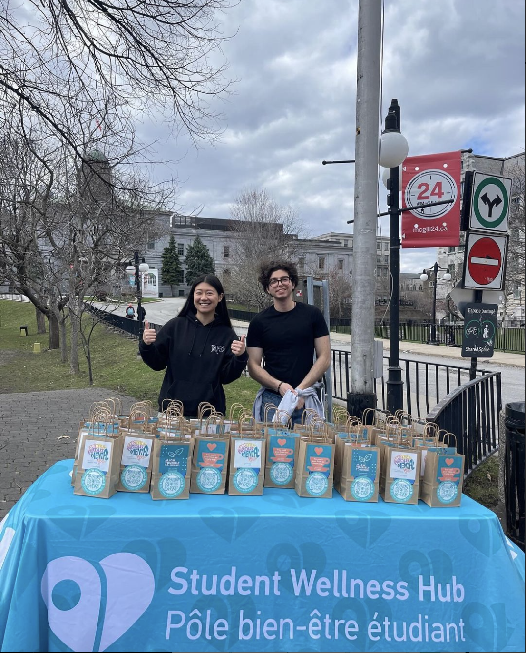
Wellness Activities
Key Takeaway: Low turnout of wellness activities leads to events being cancelled at times
Notes:
Mcgill has been kind enough to organizes many events
More oftent than not the turn out is usually low or they get cancelled
Story from healtghier mcgill ->
Low turnout

Slide 4


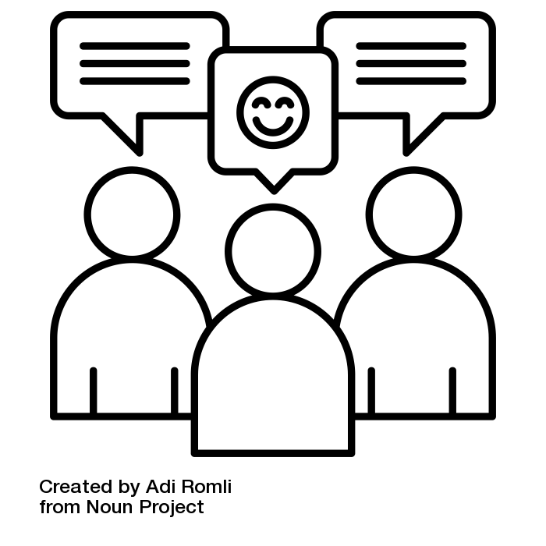
Problem Statement
Why it matters:
Impeded dissemination of resources
hindering performance & retention
To foster a more supporting educational environment, optimizing dissemination of resources & team building strategies
Inadequate communication strategies within student social networks impede the dissemination of support resources, hindering academic performance and retention
Social Mobility Restrictions limiting
University potential
tailored communication strategies: bridging groups for homophily-driven networks and engaging influencers as service ambassadors
Information diversity bottlenecks due to alike staying in cliques impeding university performance potential in terms of school projects, projects and extra curricular-activites
Notes:
Impedement Dissemination of rsources
Social mobility

Slide 5



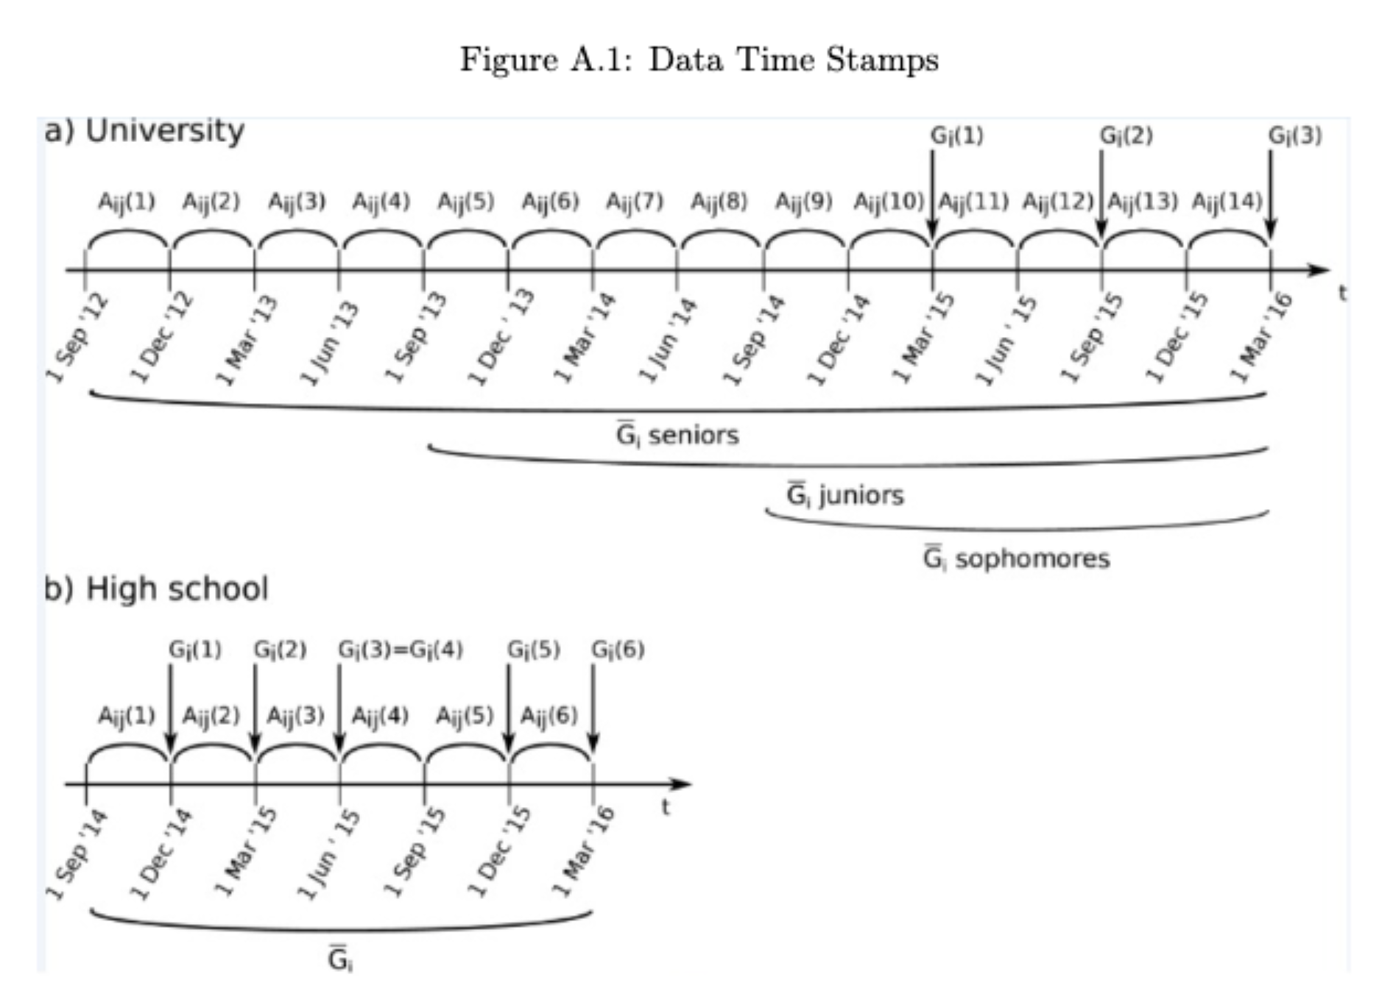
Data Strategy
Model building on Proxy data School Network Interaction Data with capability to expand to real McGill Students Network
Proxy Data Sourcing:
Considerations: Realism, Scale, Unfiltered/Organic
Source: .mat file (research paper)
Data Description:
Dataset containing info about the detailed evolution of a friendship network of 6,000 students across 42 months based on social interactions between Russian students from a public high school and a university
The dataset contains information on the students’ academic performance at several time points during their studies together with the detailed information about the evolution of their friendship networks
Model 1
Network Transformation
ETL
Model 2
Model 3
^{.mat file}
^{.csv file}
Model 4
Student networks (6000 students) from VK, Russia’s largest social site, formed by mutual likes within a timeframe used as proxy

Slide 6
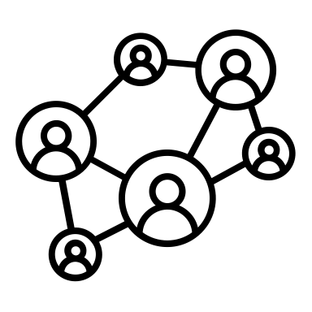


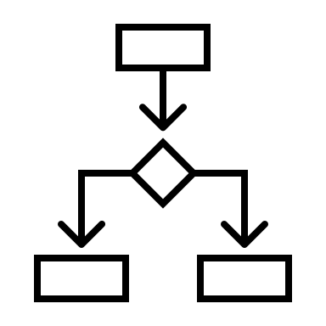
Solution Approach
We analyze student friendship networks over time, integrating social data with academic performance (GPA). Method includes - tracking network changes over time, assessing homophily, predicting GPA based on network features, & identifying student communities to find intervention points
Step 1: Network Construction
& Time Evolution of Network
Step 2: Homophily
Tests
Reference Paper
Homophily Index
Hypothesis Testing
Step 3: Regression
& SHAP Analysis
Random forest to predict academic performance based on network attributes
Step 4:
Community-Influencer Identification
Greedy Algorithm to find communities
Hits Algorithm to find key nodes

Slide 7
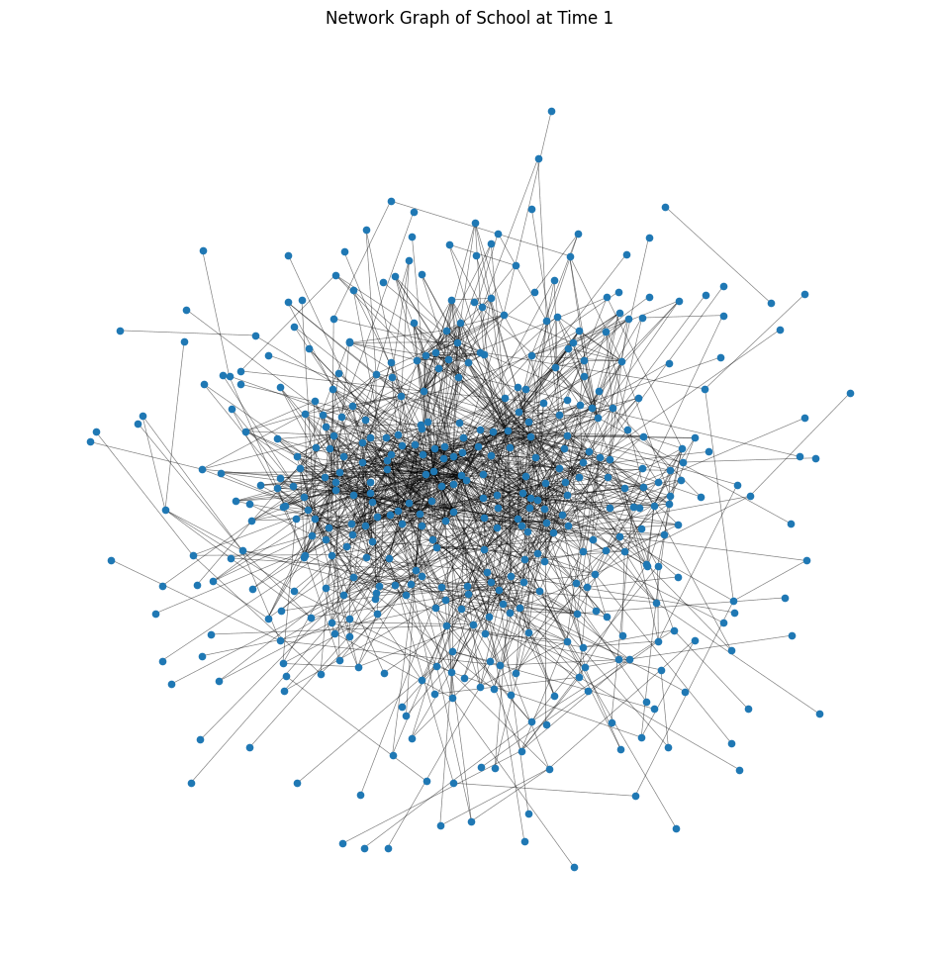
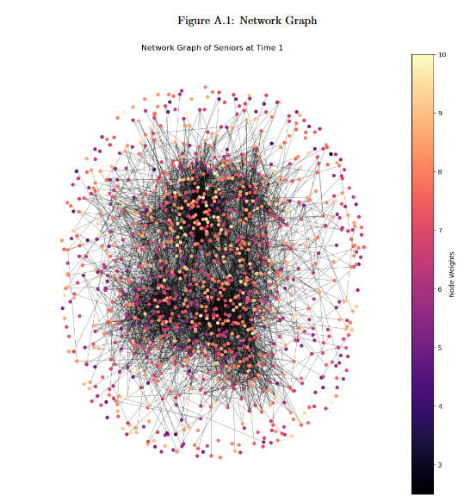
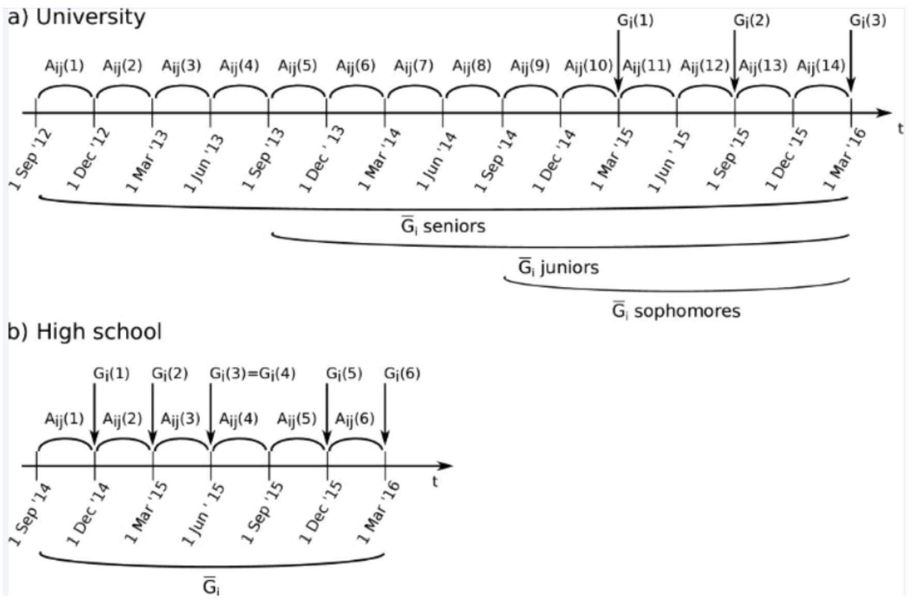
1. Network Construction
Network Construction:
Construct friendship networks for high school and university students
Nodes represent students,
Edges represent exchanged "likes”
“Friendship links approximated from "likes" on each other's pages. i.e., Link formed if at least one "like" exchanged within a timeframe.”

Slide 8
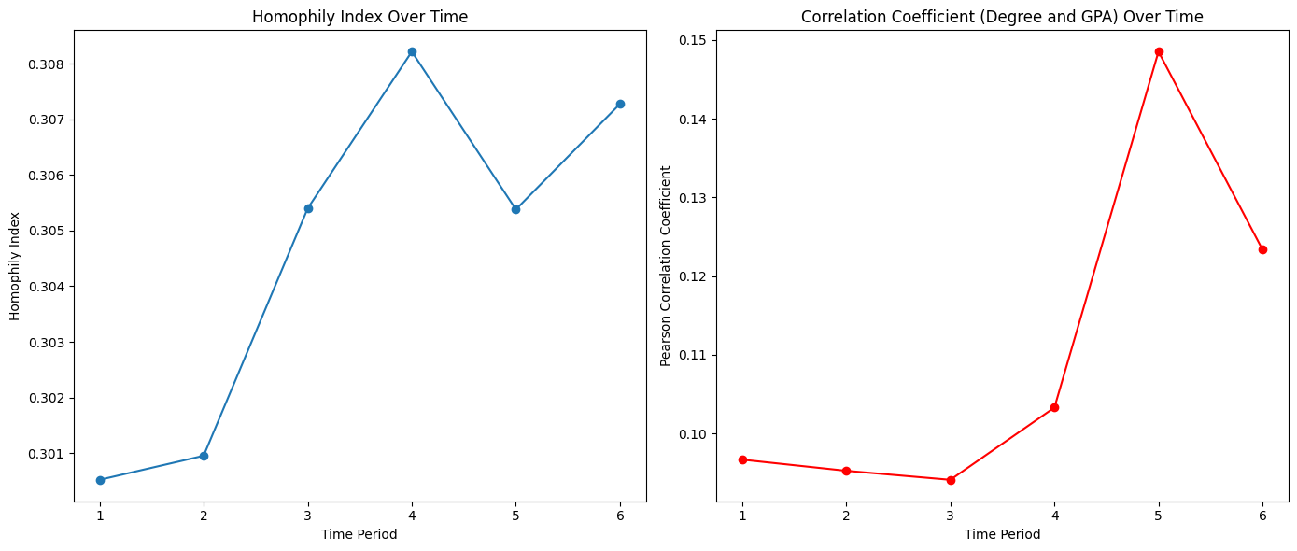
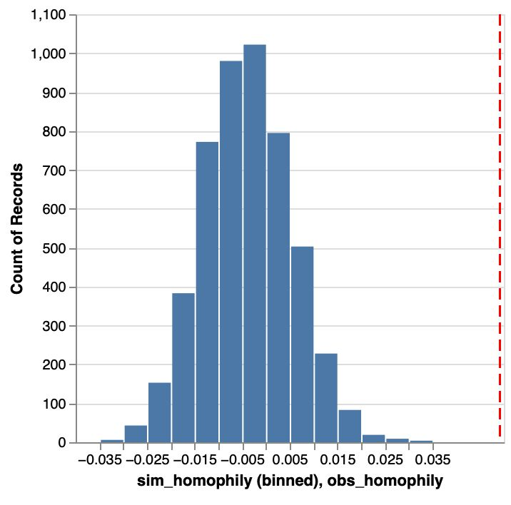
2. Homophily Testing
A. Homophily Index & Pearson Coefficient:
Quantifies the extent to which students with similar GPAs are more likely to be friends than those with dissimilar GPAs.
The Pearson correlation coefficient calculated b/w students' GPA & their degree centrality within the network. This correlation measures whether students with higher GPAs tend to have more connections (higher centrality)
B. Homophily Hypothesis Testing:
Permute node attributes in a graph to assess structure sensitivity, focusing on mixed edges with differing attributes.
(If the fraction of cross-gender edges is significantly less than 2pq, then there is evidence of homophily)
Red line measure as the different between the expected percentage of mixed edges and the observed percentage of mixed edges.
P value <<0

Slide 9
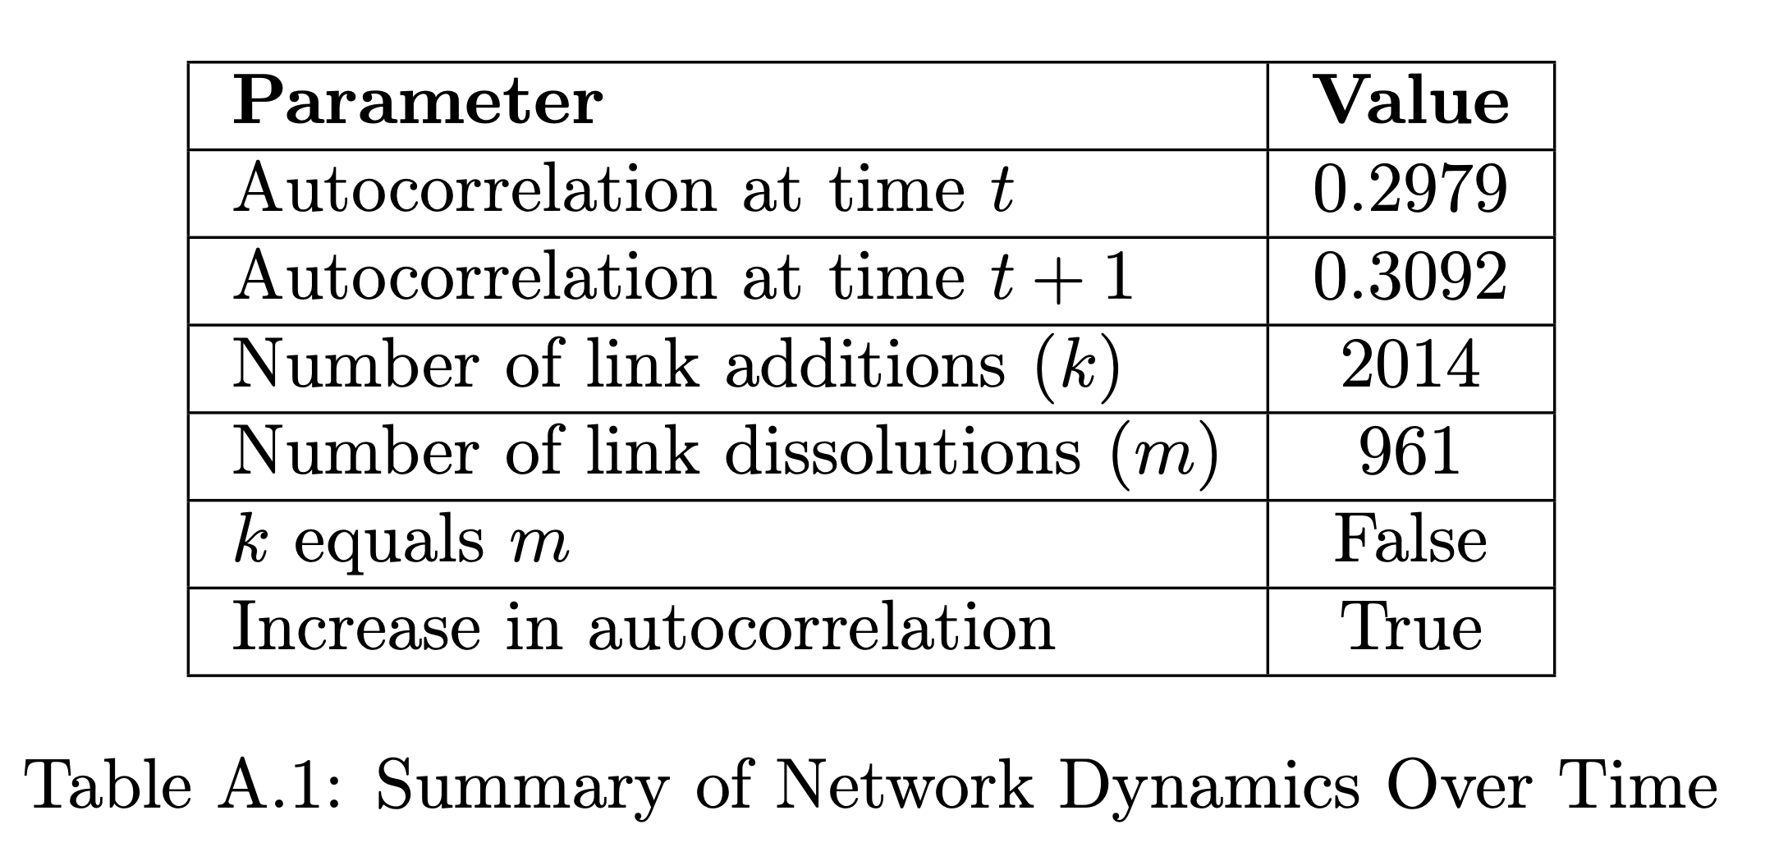
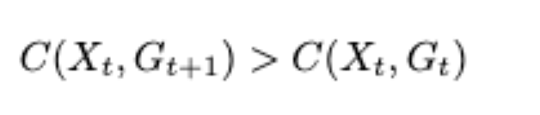
2. Homophily Testing
Autocorrelation Increase:
The increase in autocorrelation from 0.298 at time t to 0.309 at time t+1 suggests that the network became more homophilous over time. This means that nodes increasingly connected with other nodes that are similar to themselves.
Also, 2014 links being added and only 961 dissolved, suggest that the network's structure is evolving in a way that possibly increases homophily, leading to a more homogeneously connected network over time.
C. Relational autocorrelation:
We used the auto correlation theorems mentioned in paper cited below and tested the homophily gain. The concept is
If a homophily effect is present in the data, the autocorrelation will increase when we consider the link changes from time t to time t + 1:
(Homophily Gain)
Concept Reference:
Timothy La Fond and Jennifer Neville. “Randomization Tests for Distinguishing Social Influence and Homophily Effects.” In: Apr. 2010, pp. 601–610.
doi: 10.1145/1772690.1772752.
Key Takeaway: All three tests confirm homophily dominance in network

Slide 10
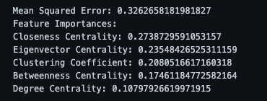
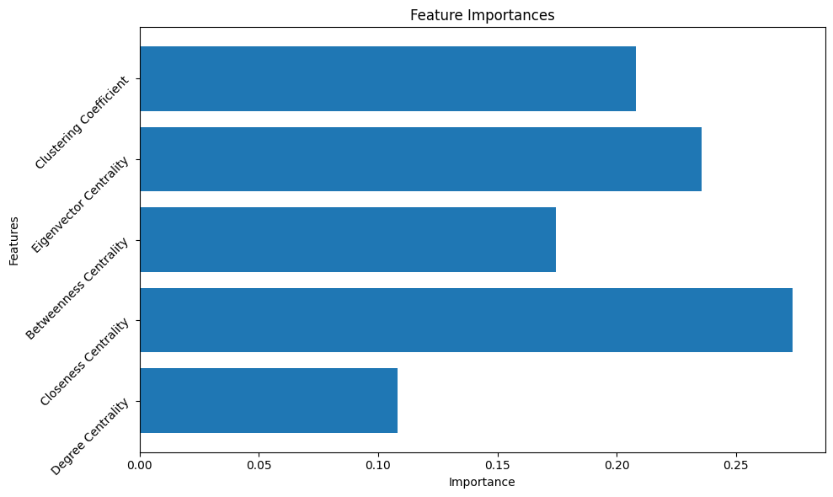
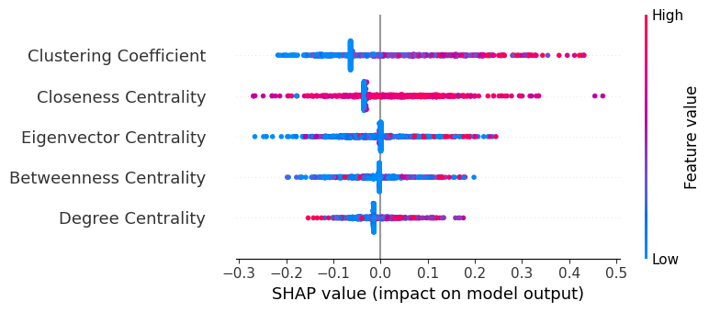
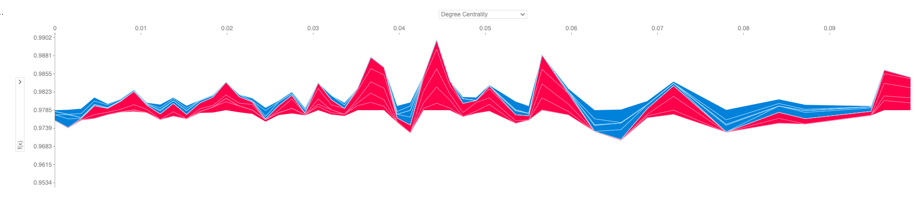
3. Regression
Random Forest Model:
A Random Forest Regression Model was developed to predict GPA using centrality features as predictors. Please refer figure on right for global feature importance
Explainability AI With SHAP:
Subsequently, the Explainity AI model was scrutinized to extract valuable business insights from its SHAP values. Please refer SHAP value plot on right
Key Takeaway: Resources can be strategically & preemptively pushed to students with low centrality scores

Slide 11
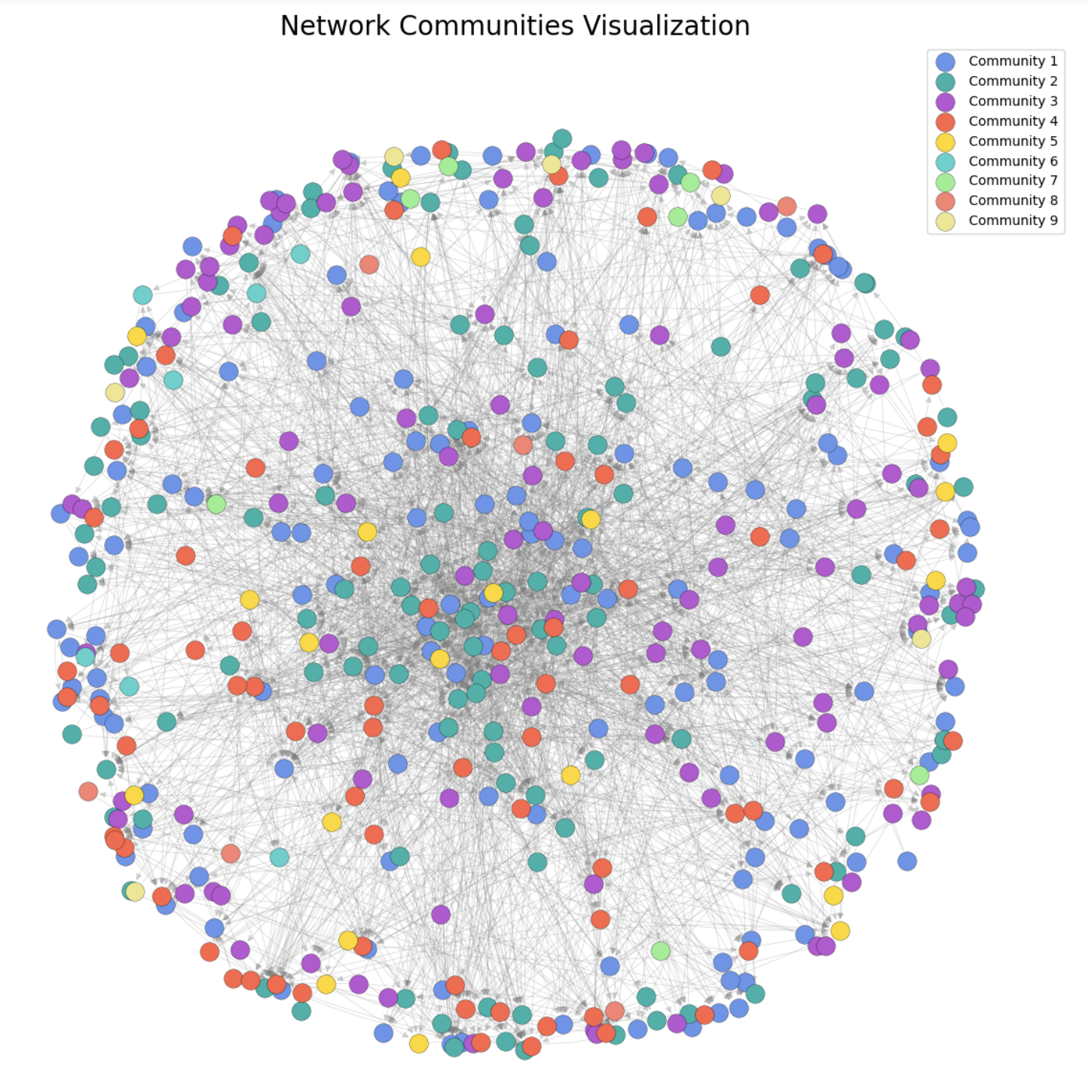
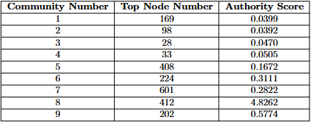
4. Community Detection
Greedy Modularity:
Greedy Modularity algorithm, designed to optimize the modularity of a network using the GPA as weights, allows us to effectively identify & analyze the community structure within the student networks over time. Results: clear delineations of student clusters
HITS Algorithm - Identifying core nodes:
Once we identified the communities, we applied the HITS algorithm to identify the core students in the homophily groups, categorized into "hubs" and "authorities." Here is the table for top for Authority notes in each community ->
Notes:
Talk about why? Since n/w is homophily we go on to find the communities within that n/w
We couldn't use Girvan Newman Algorithm --> since it works on fully connected graphs, and this n/w was by no means a fully connected graph.
Greedy Modularity approach ---> Key concept of Modularity: metric that quantifies the quality of a division of a network into communities.
High modularity indicates that there are dense connections between the nodes within communities and sparse connections between nodes in different communities.
Target --> Hyperlink Induced Topic Search for finding information dissemination

Slide 12
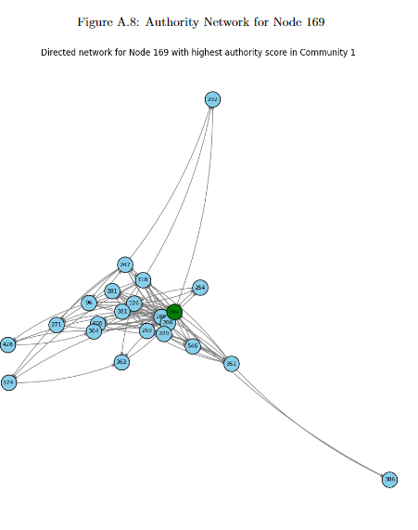

1. Started with Network Graph
of School (Over Time)
Directed Network for Node 169 with highest authority score in Community 1
3. Greedy Modularity gave us network communities
4. Central node in Community 1 Identified for Targeted Intervention
2. Homophily detection
Key Takeaway: Information dissemination can be done through the identified core nodes
Notes:
implying it's a key source of information within that community.
The highlighted node might be the focus for targeted intervention, such as academic support or information dissemination.
By identifying the central authority nodes within each community, it's possible to strategically target interventions, resources, or information to influence or support the network most effectively, especially for nodes with low centrality scores.

Slide 13
Conclusion
Study revealed significant insights into the structural dynamics of student social networks and their influence
on academic performance
Findings
Actionable Insights
Homophily Dominance:
Students prefer to gradually reorganize their social networks according to their performance levels, rather than adapting their performance to the level of their local group.
<<
Prediction of GPA with Network Centrality (Low RSME):
Students with high network centrality attributes are scoring higher GPA; Influence & performance walking hand-in-hand
Identification of Communities & Influencers:
Communities and influencers within communities are identified which gives transparency into POCs for dissemination and targets for resource utilization drives
Tailored Communication Strategies:
Develop targeted communication strategies that consider the network’s homophily characteristics to ensure information reaches all groups within the student body.
Group Formation Strategy for Increased social mobility:
Network centrality can be used to find students who need help the most; Random Grouping can be used to elevate class performance.
PoC Leads for Outreach Amplification:
Engage identified core nodes within the homophily group networks leveraging their positions to enhance outreach and engagement.
Business Value and Expected Impact - Tailored strategies ensure inclusive communication, fostering engagement and cohesion among diverse student groups.
- Targeted support initiatives enhance academic outcomes, reducing dropouts by addressing specific student needs effectively.
- Engaging influential nodes amplifies outreach efforts, maximizing dissemination impact & promoting community involvement.
Notes:
Homophily dominance – students tend to stay in their cliques based on performance
GPA prediction with low RSME using network centrality
Communities and influencers can be seamlessly identified
Actionable insights - tailored communication

Slide 14

Recommendation Examples
1
66% Increase in Batch Strength
Increase Batch Size demands changes in network optimization for dissemination of resources
This year MMA6 had a council of 9 instead of 2 class reps led to a significant event participation increase!
+66%
MMA5
MMA6
3x
Event Participation

Slide 15
Thank you
Questions & Answers

Slide 16
Appendix

Slide 17
Greedy Modularity Algorithm
Modularity:
This is a metric that quantifies the quality of a division of a network into communities. High modularity indicates that there are dense connections between the nodes within communities and sparse connections between nodes in different communities.
Greedy Algorithm:
This method applies a greedy optimization approach to maximize modularity. It starts with each node in its own community and progressively merges communities that result in the greatest increase in modularity. This stepwise optimization continues until no further improvement in modularity can be achieved.
Steps:
Start with Each Node as a Community
Calculate Possible Gains
Identify the pair of communities that results in the highest increase in modularity.
Combine the two communities into a single community. Update the network structure accordingly, treating the merged entity as a single community.
After merging the two communities, it's necessary to update the modularity change calculations for any community pair that involves the newly formed community.
If the merge resulted in an increase in the overall modularity of the network, go back to Step 2 and consider the next set of possible merges.

Slide 18
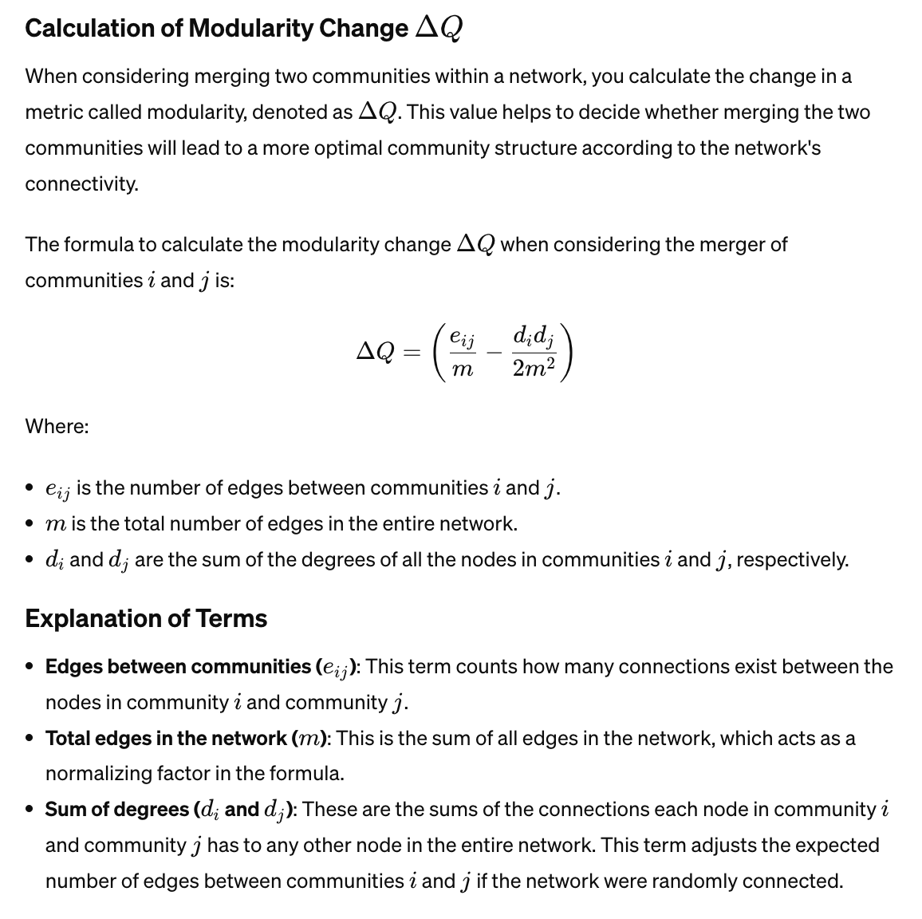
Greedy Modularity Algorithm

Slide 19
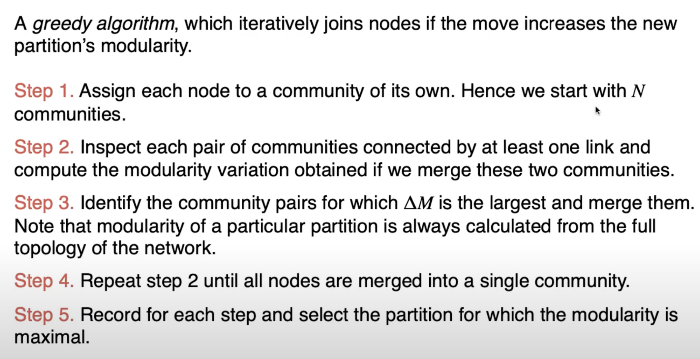
Greedy Modularity Algorithm
Ref- https://www.youtube.com/watch?v=YNCpqP7q_TE&ab_channel=RabeehAbbasi

Slide 20
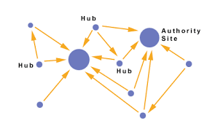
HITS Algorithm
Hyperlink Induced Topic Search (HITS):
Link Analysis algorithm.
Hubs:
Hubs are nodes with a high number of outgoing links to authorities, indicating they serve as great pointers to valuable resources.
Authorities:
Authorities are nodes with a high number of incoming links, suggesting they are valuable sources of information.
Once the communities were established, the HITS algorithm was applied to these communities to identify which nodes within them are core nodes—either as hubs or authorities.

Slide 21
Academic Darwinism:
Social Network Dynamics in Students
Final Project – Social Media Analytics
Arham Anwar | 261137773
Arnav Gupta | 260658711
Ethan Pirso | 260863065
Jatin Suri | 261152263
Hongyi Zhan | 261159589

